Slide 1
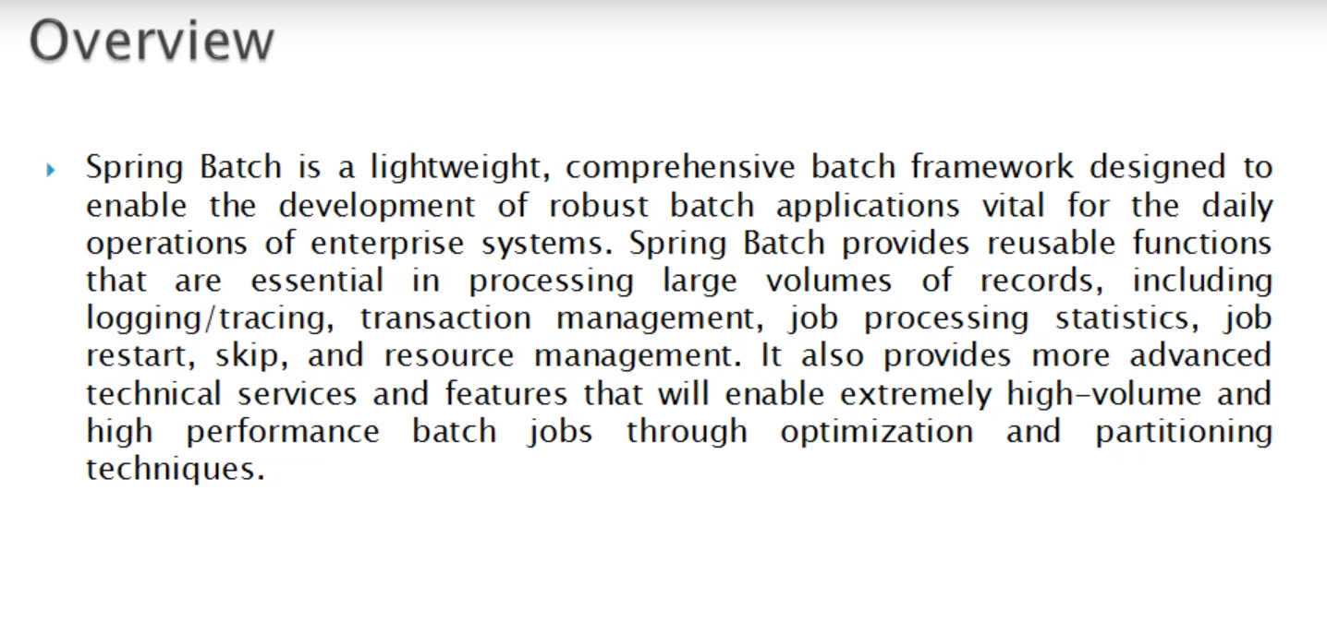
Overview

Slide 2
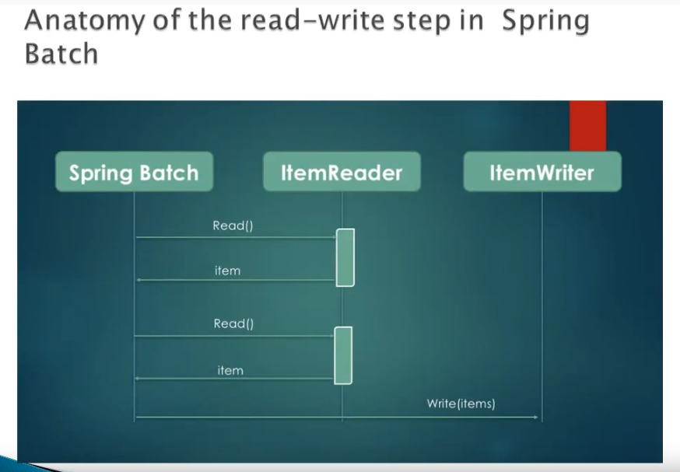
Spring Batch- Overview

Slide 3
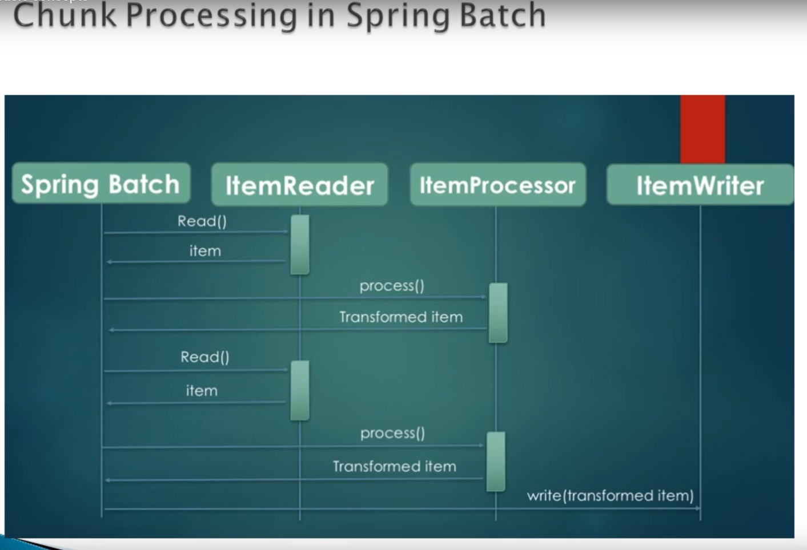
Spring Batch- Overview

Slide 4
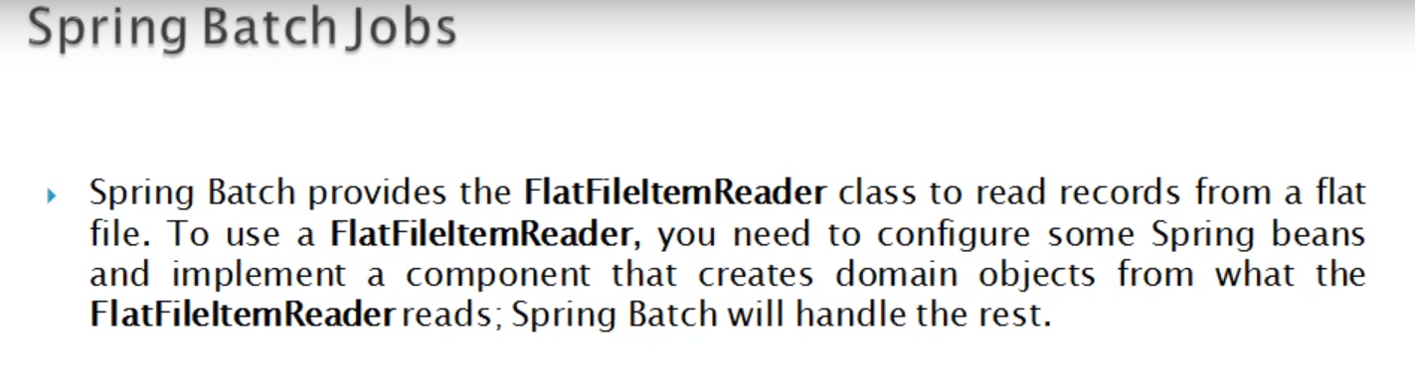
Spring Batch- Overview

Slide 5
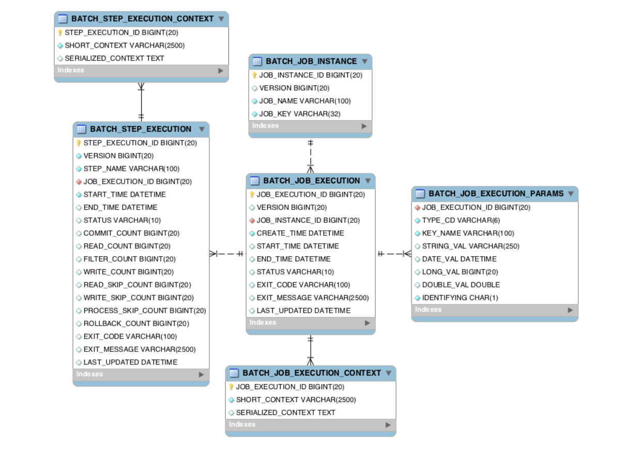
Spring Batch- Overview

Slide 6
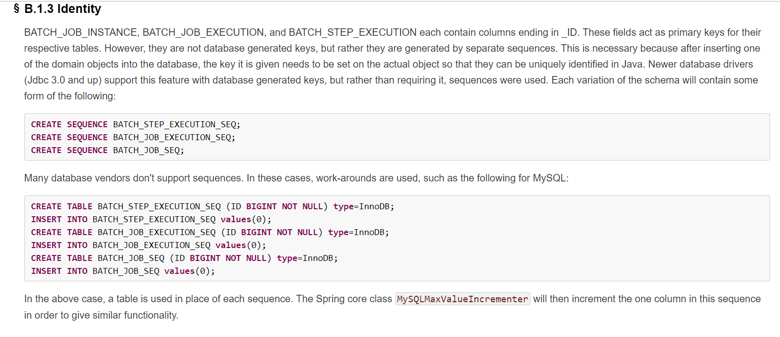
Spring Batch- Overview

Slide 7
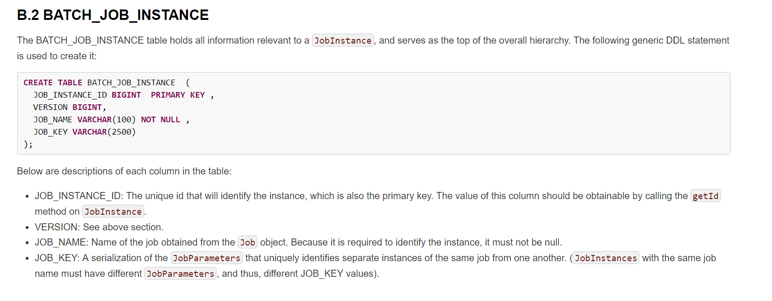
Spring Batch- Overview

Slide 8
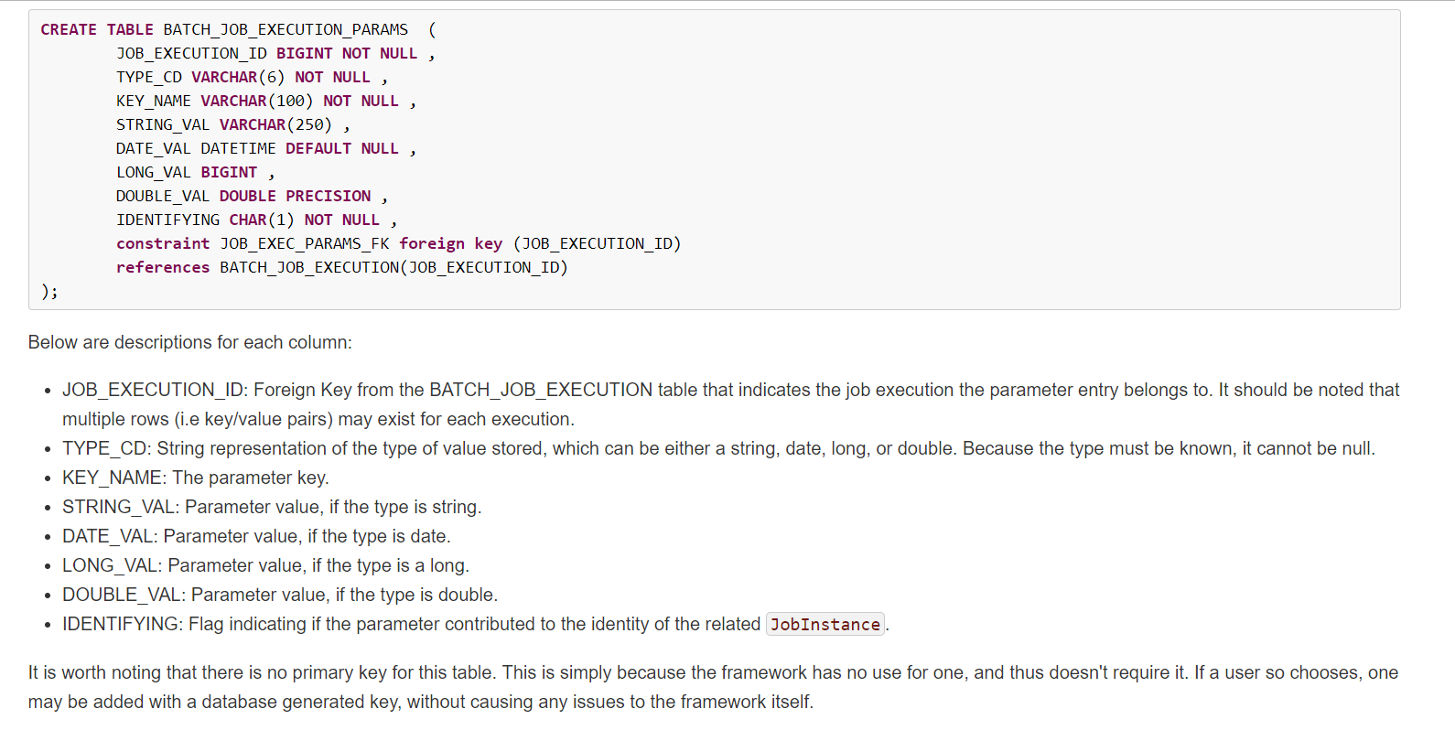
Spring Batch- Overview

Slide 9
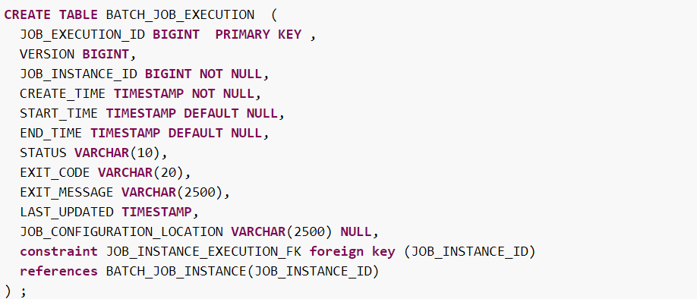
Spring Batch- Overview

Slide 10
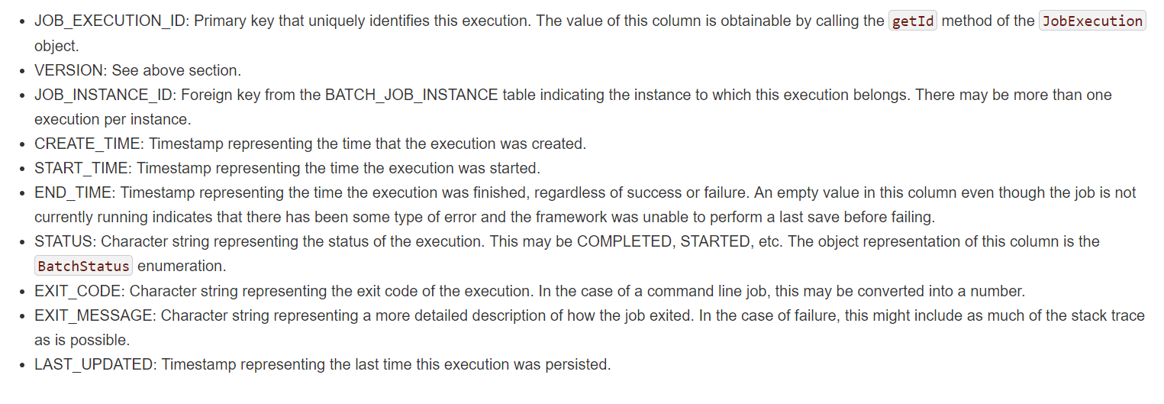
Spring Batch- Overview

Slide 11
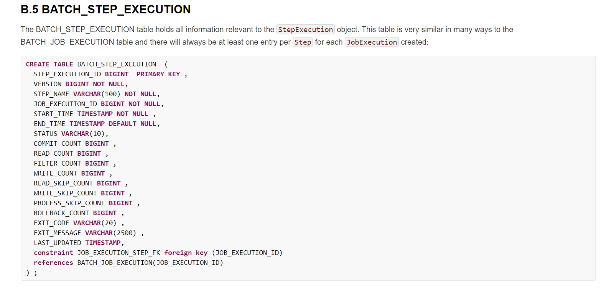
Spring Batch- Overview

Slide 12
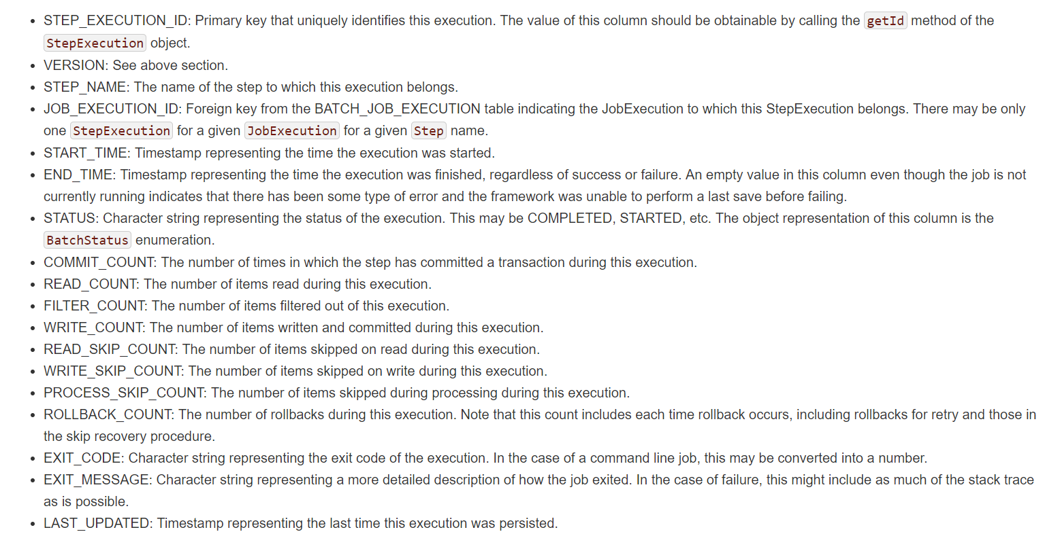
Spring Batch- Overview

Slide 13
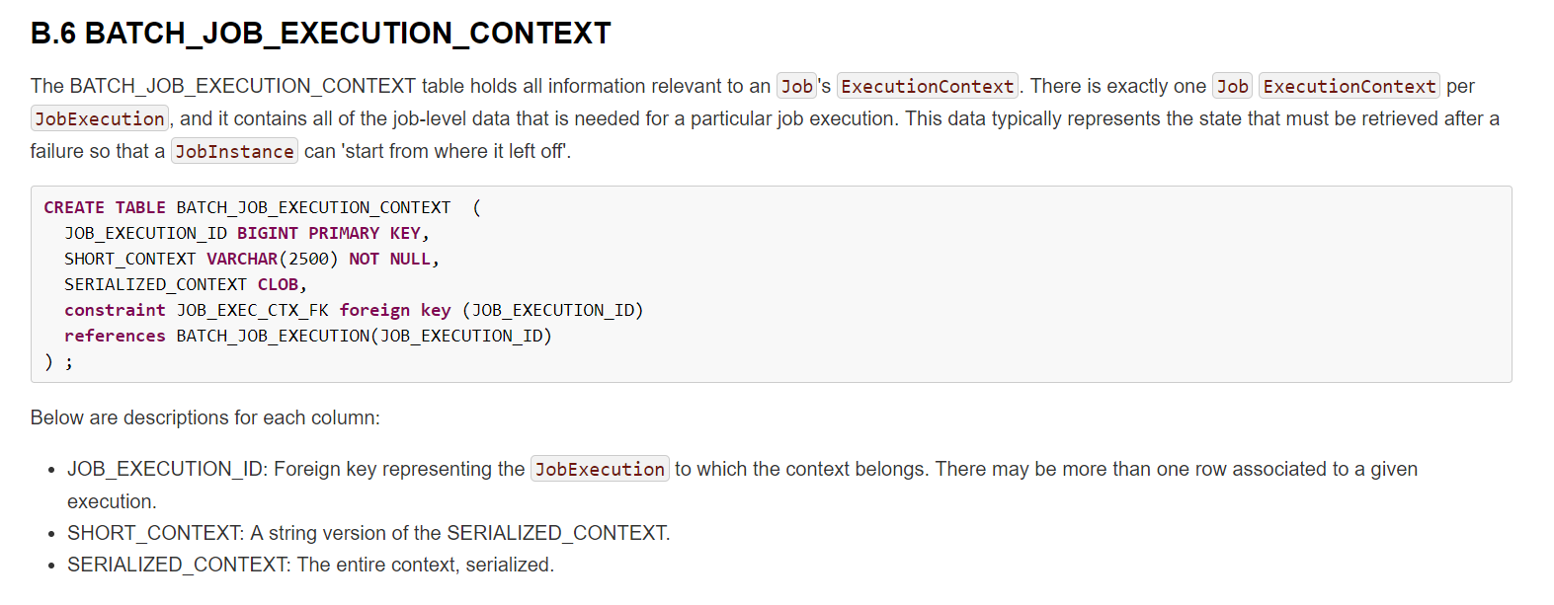
Spring Batch- Overview

Slide 14
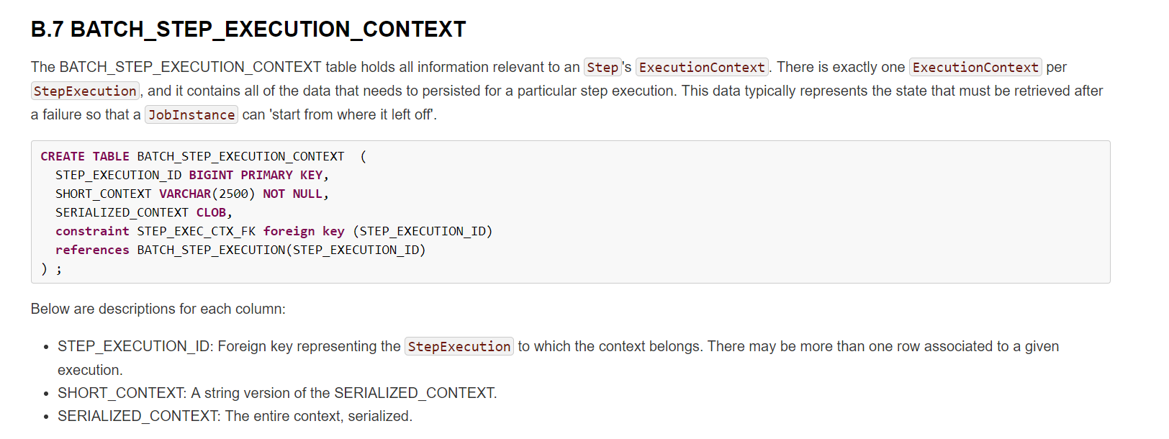
Spring Batch- Overview

Slide 15
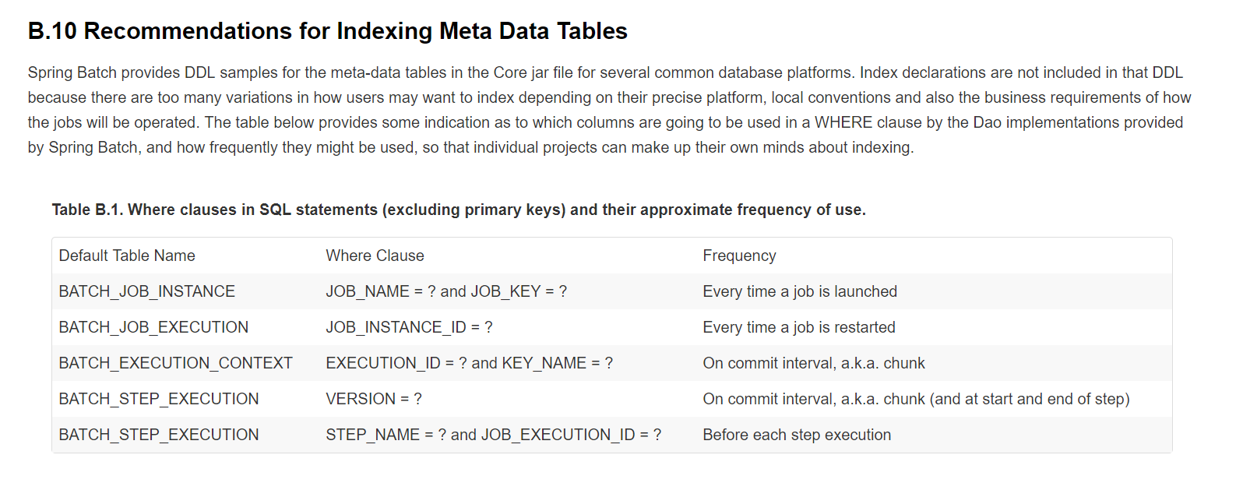
Spring Batch- Overview

Slide 16
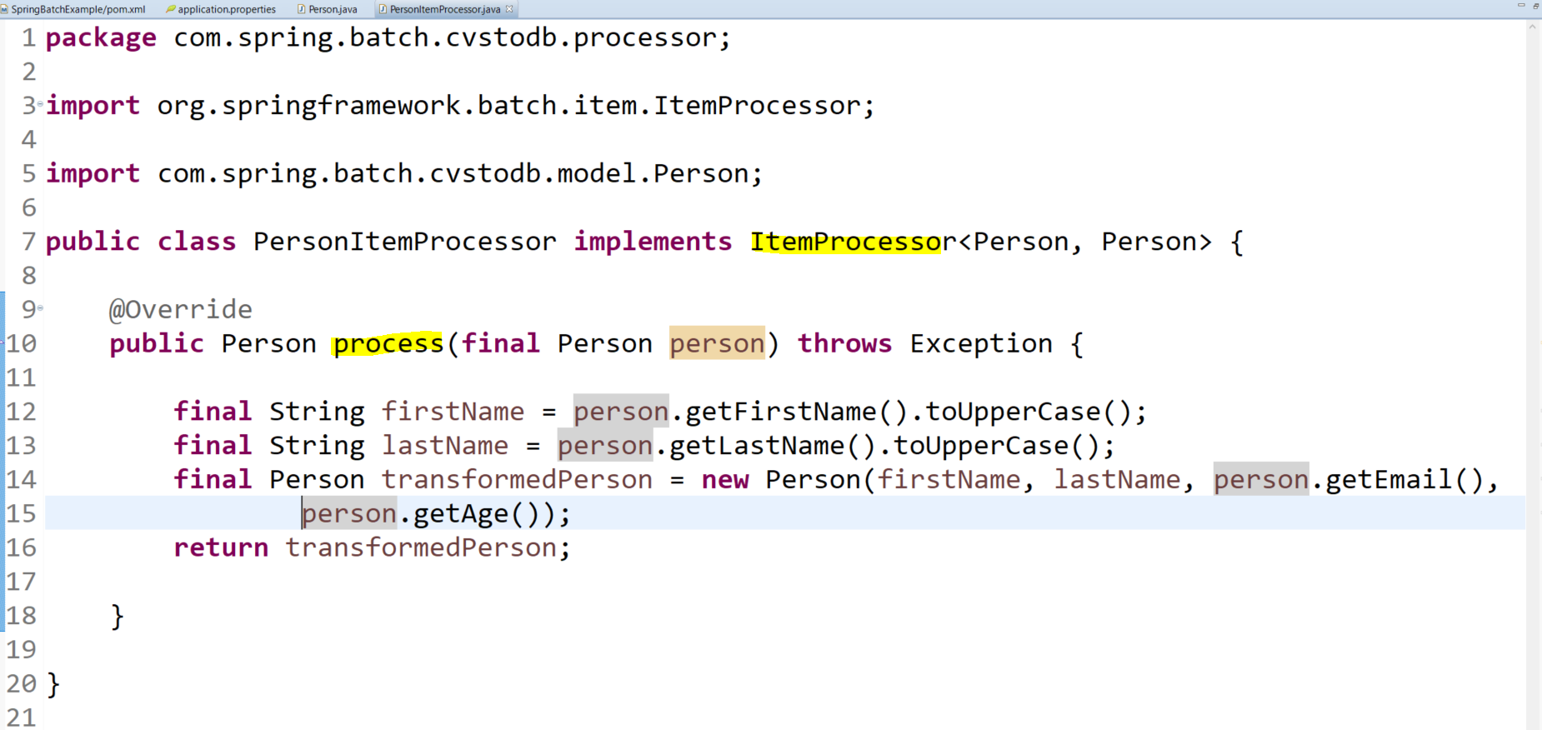
Spring Batch

Slide 17
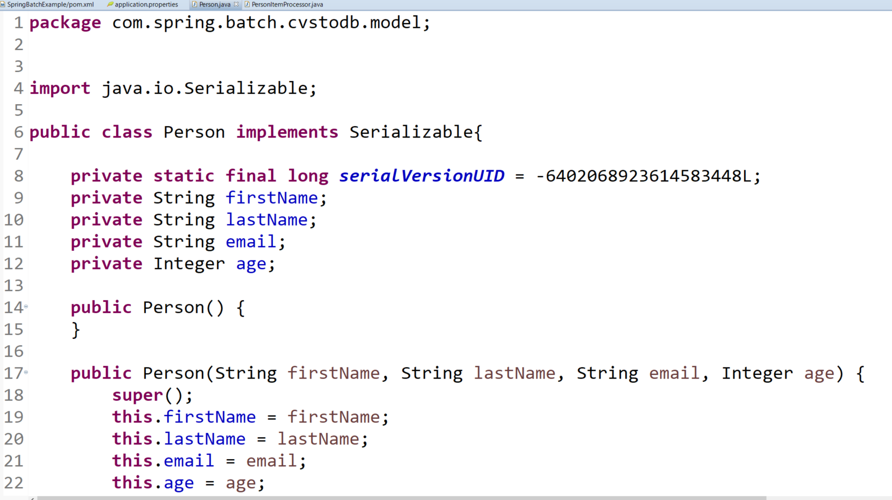
Spring Batch

Slide 18
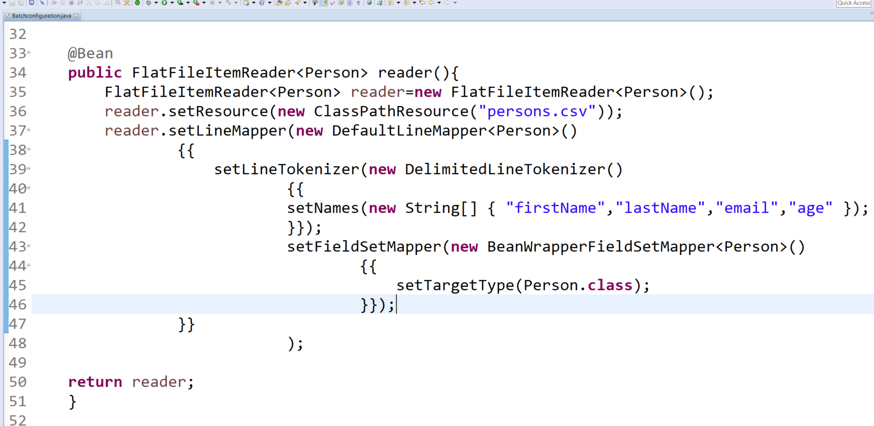
Spring Batch

Slide 19
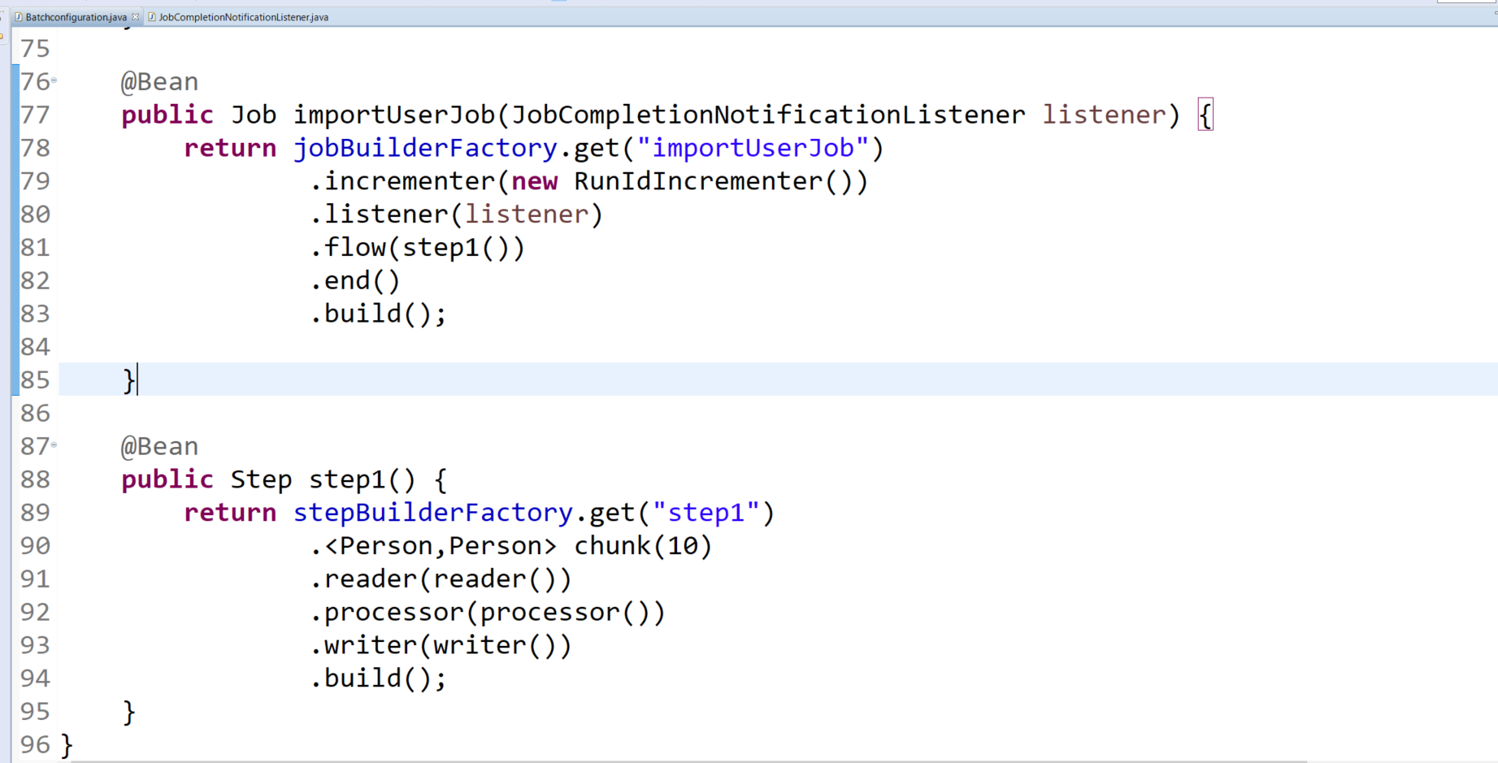
Spring Batch

Slide 20
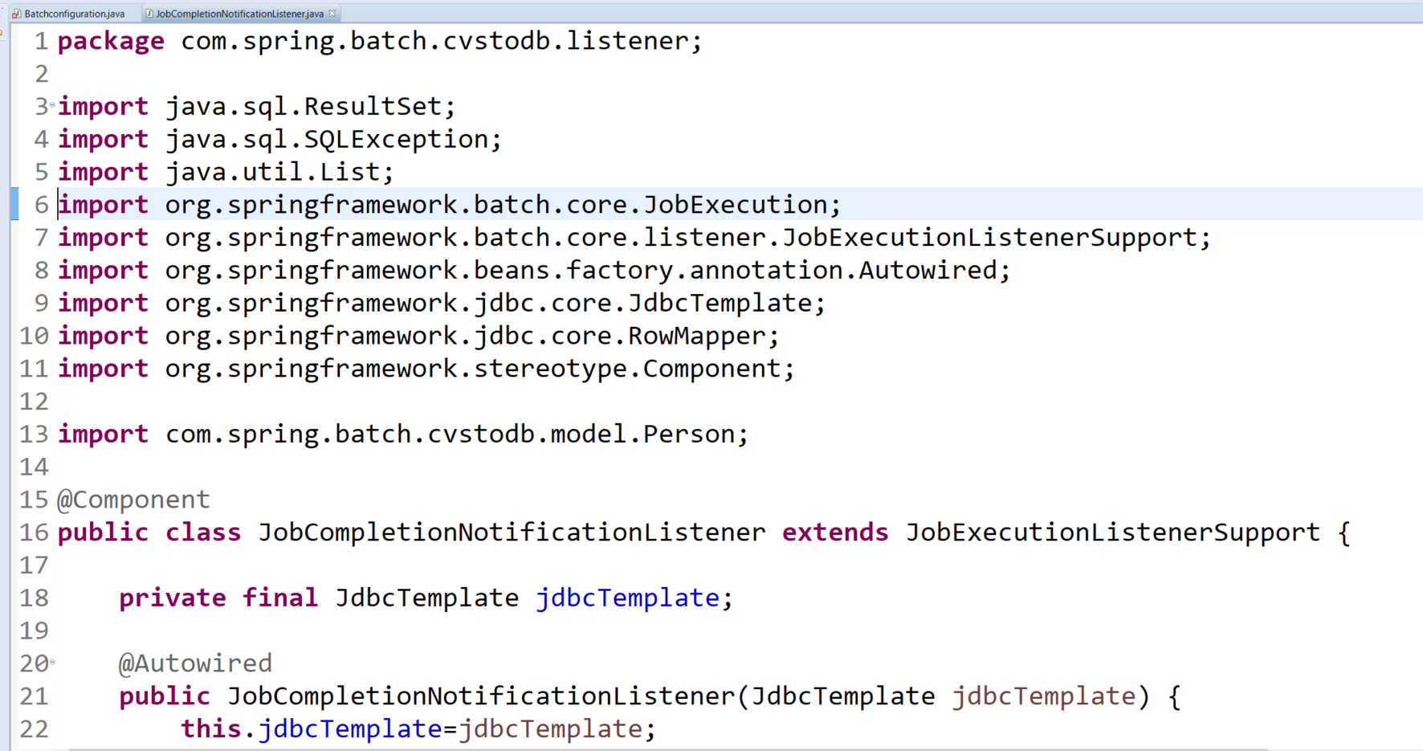
Spring Batch

Slide 21
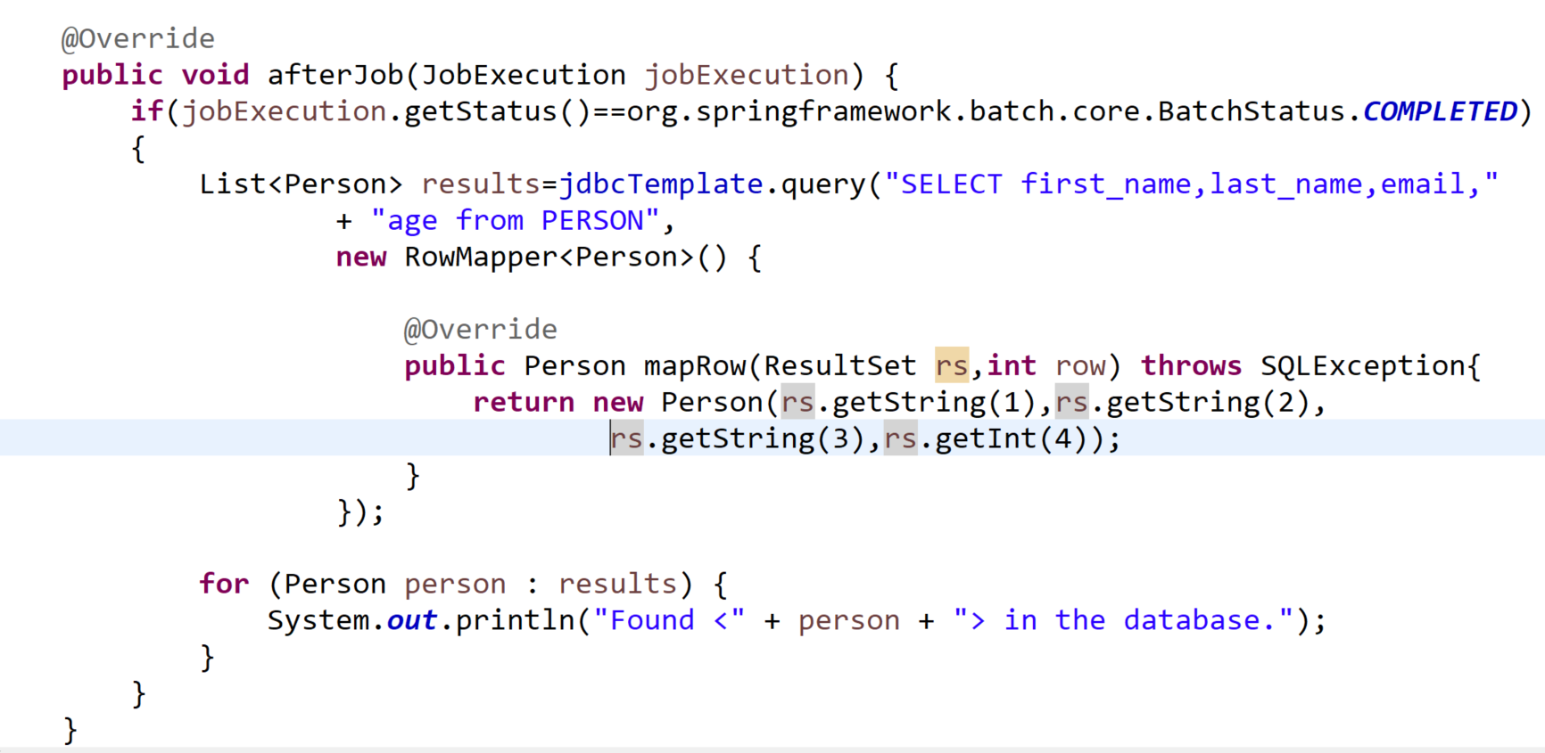
Spring Batch

Slide 22
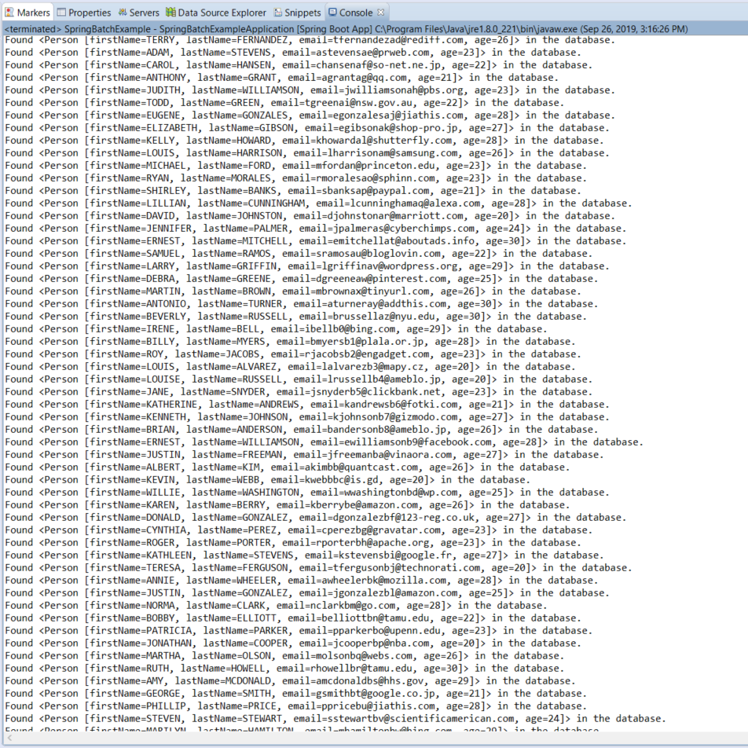
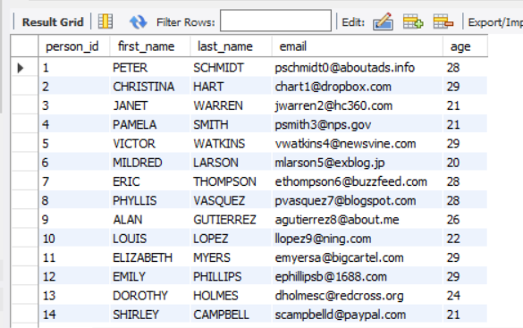
Spring Batch

Slide 23
Project Source Code
CSV File

Slide 24
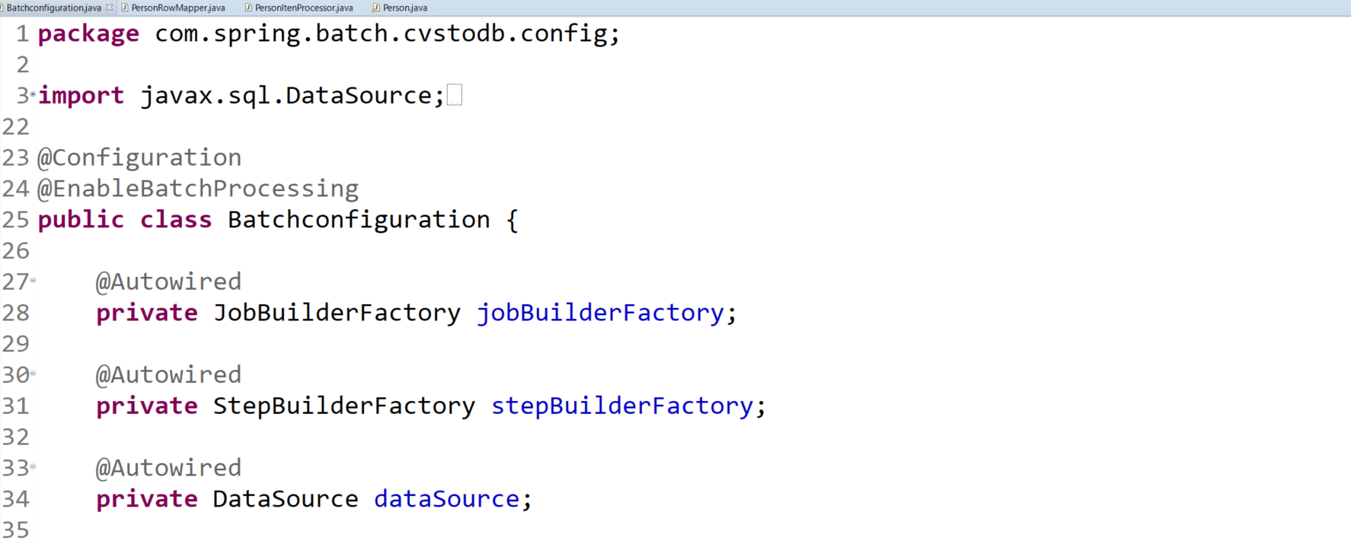
Spring Batch – DB To csv File

Slide 25
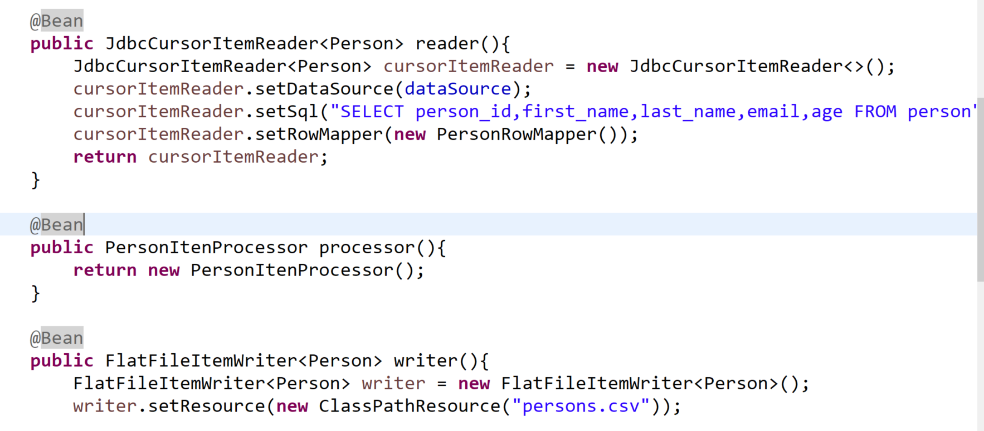
Spring Batch – DB To csv File

Slide 26
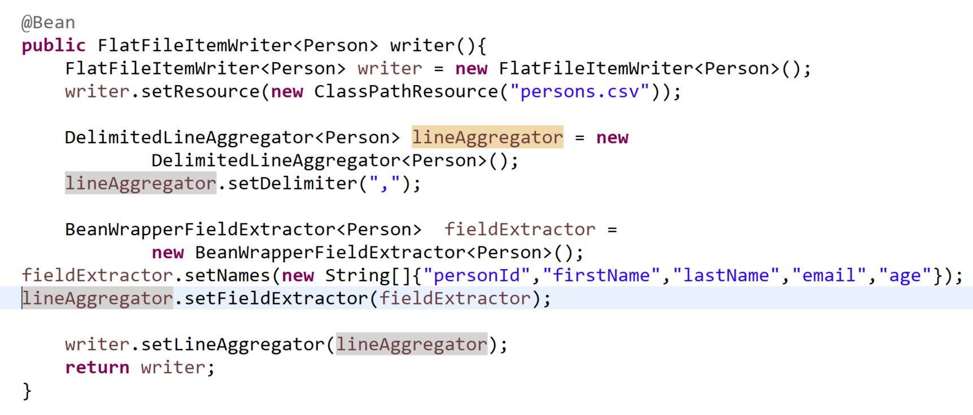
Spring Batch – DB To csv File

Slide 27
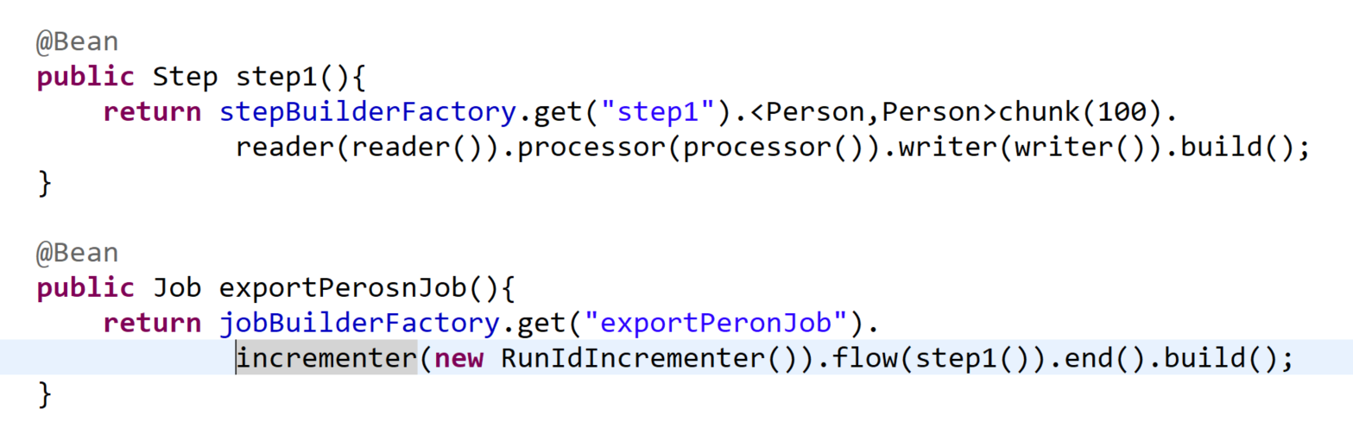
Spring Batch – DB To csv File

Slide 28
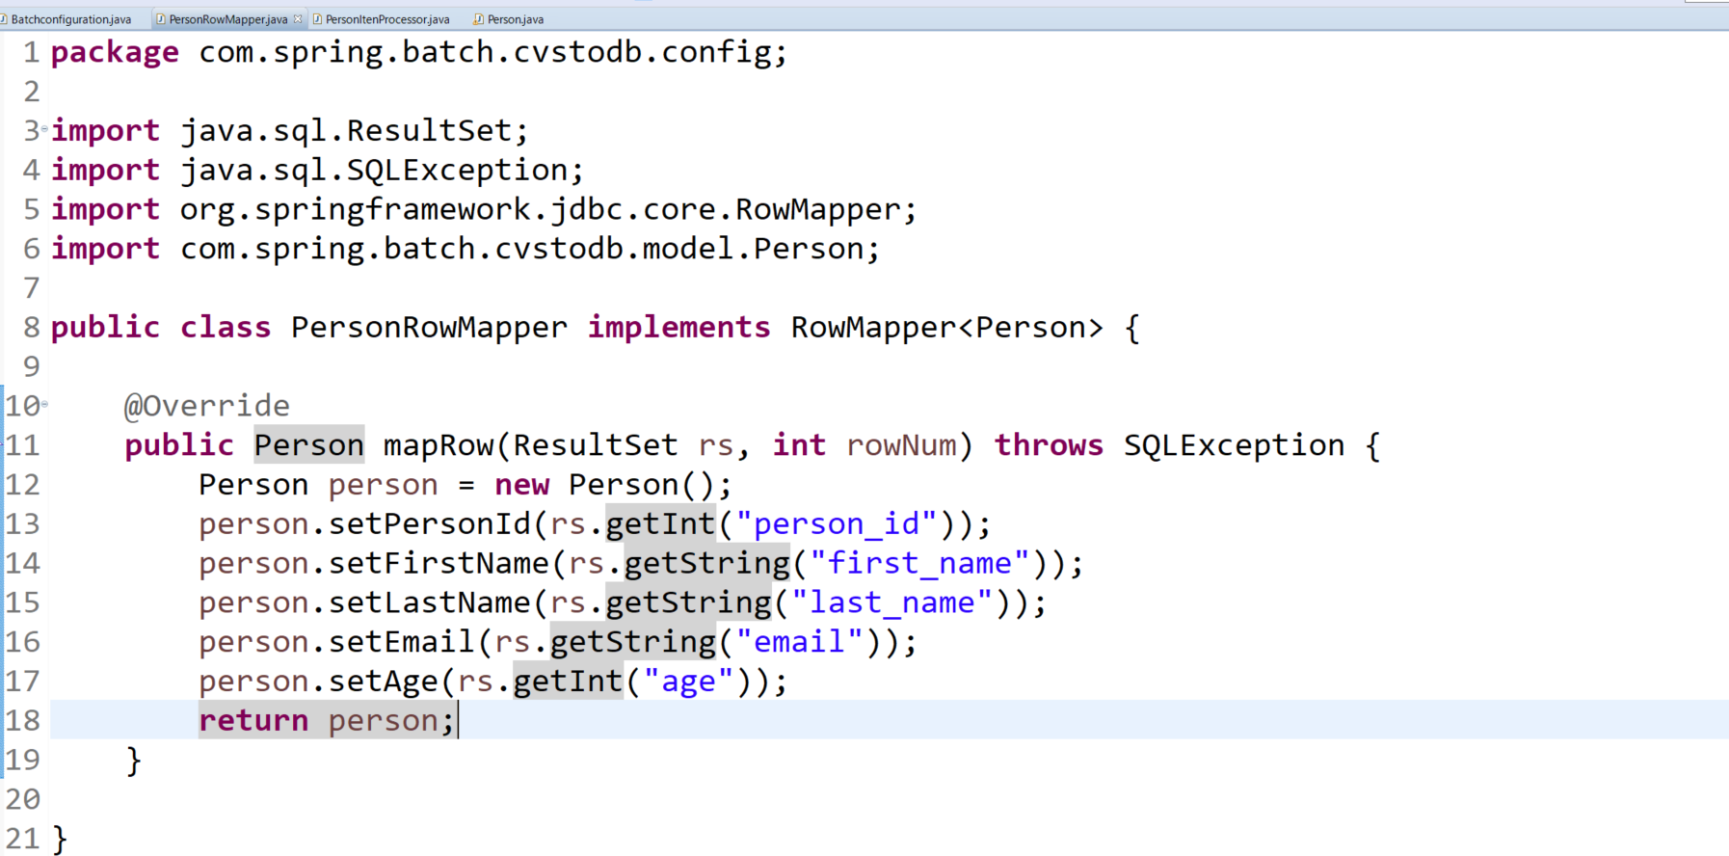
Spring Batch – DB To csv File

Slide 29
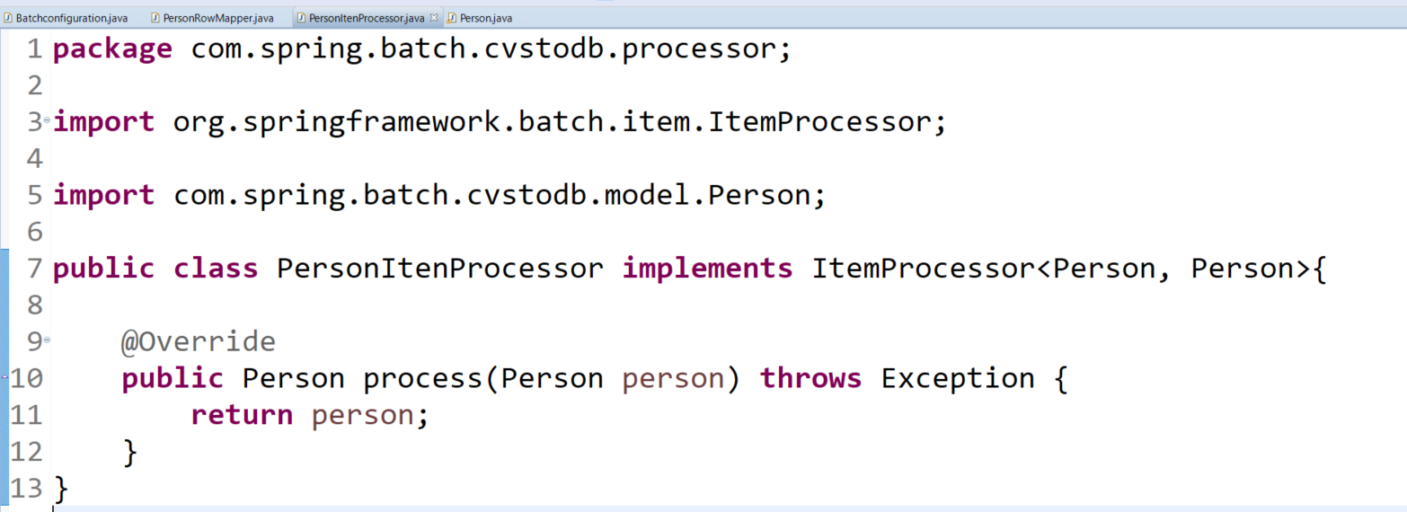
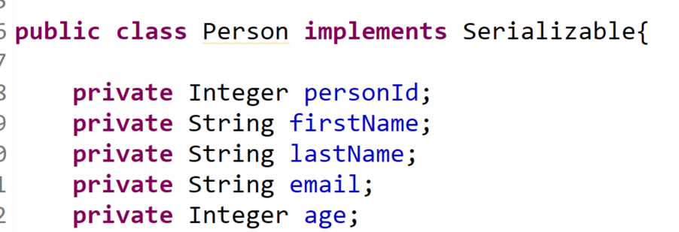
Spring Batch – DB To csv File

Slide 30
Project Source Code

